Slide 1
Adidas US Sales Dashboard
adidas

Slide 2
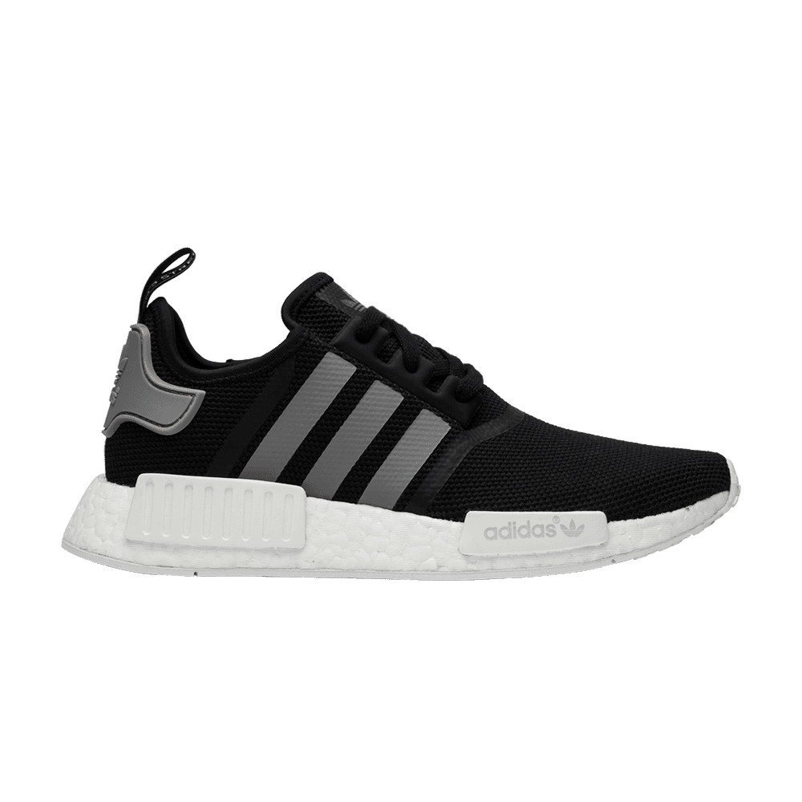
Objective
The objective of this dataset is to analyze and understand the sales performance of Adidas products across various regions, states, and cities. By examining key metrics such as total sales, units sold, price per unit, operating profit, and operating margin, the dataset aims to provide insights into the financial health and profitability of different product categories. Additionally, it allows for the evaluation of sales methods (e.g., in-store) and the identification of top-performing retailers and geographic locations. This analysis can help in strategic decision-making, optimizing inventory management, and tailoring marketing efforts to maximize sales and profit margins.

Slide 3
DataSet Overview
• Total Dataset Analyzed – 1
• Total Number of Columns - 13
• Total Number of Rows - 9648
• Key Metrics: Number of datasets, average size, average number of files, etc.
• Visual: Decomposition Tree or Stacked Chart to show the distribution of dataset.
We will always strive to expand the boundaries of human possibility, to include and unite people in sport, and to create a more sustainable world.

Slide 4

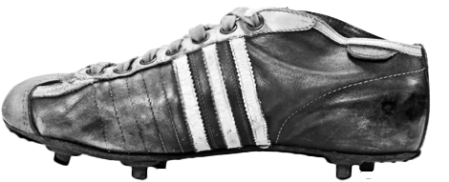
1900 - 1949
2023
THE EARLY YEARS
WELCOME BACK BJØRN
Our History
We started in a washroom and conquered the world. And in between, we’ve scored big and sometimes struggled to reach our goals. We’ve done our best for the best. We’ve improved and grown. Looking ahead to the future, always remembering where we came from. This is our story.
1968 - 1970
2022
THE ATHLETES’ TRUST
ADIDAS X GUCCI
1972 - 1978
MULTI-SPORTS SPECIALIST
LEADER WITH A DIGITAL VISION
1989 - 1994
2009 - 2012
INNOVATION NEVER SLEEPS
INNOVATION NEVER SLEEPS

Slide 5
Column Description for Adidas
1.Retailer: The name of the retailer that sold the Adidas products.
2.Retailer ID: A unique numerical identifier assigned to each retailer.
3. Invoice Date: The date when the sales transaction was recorded.
4. Region: The geographic region where the sale occurred (e.g., Northeast).
5. State: The state within the region where the sale took place.
6. City: The city within the state where the sale was made.
7. Product: The category and type of Adidas product sold (e.g., Men's Street Footwear).
8. Price per Unit: The selling price of a single unit of the product.
9. Units Sold: The number of product units sold in the transaction.
10. Total Sales: The total revenue generated from the sale, calculated as Price per Unit multiplied by Units Sold.
11. Operating Profit: The profit earned from the sales transaction after deducting operating expenses.
12. Operating Margin: The ratio of operating profit to total sales, expressed as a percentage, indicating the profitability of the sale.
13. Sales Method: The method through which the sales were conducted (e.g., in-store).

Slide 6
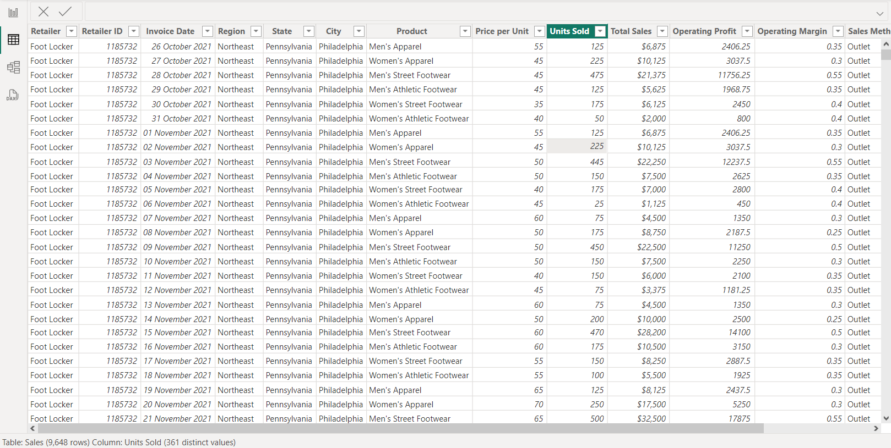
DataSet Overview

Slide 7
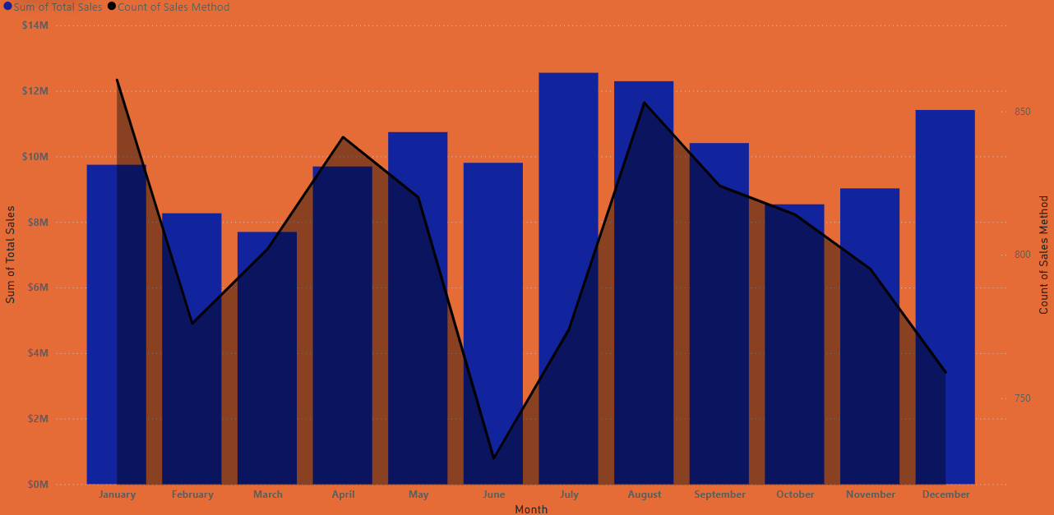
Line and Clustered Column Chart
• Insight: Trends in dataset over time.
• Visual: Line graph and Stacked chart to show the number of datasets uploaded over the years, months , day and the Sum of Total Sales

Slide 8
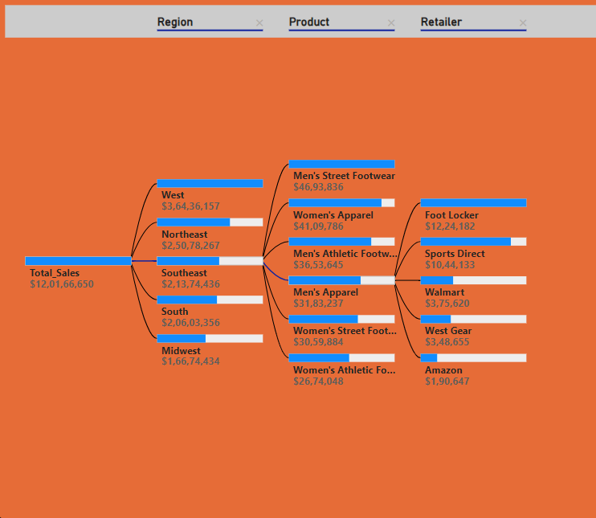
Decomposition Tree
• Insight: Distribution of Total Sales
• Visual: Decomposition Tree to show the Region in corresponding to Product and Retailer.

Slide 9
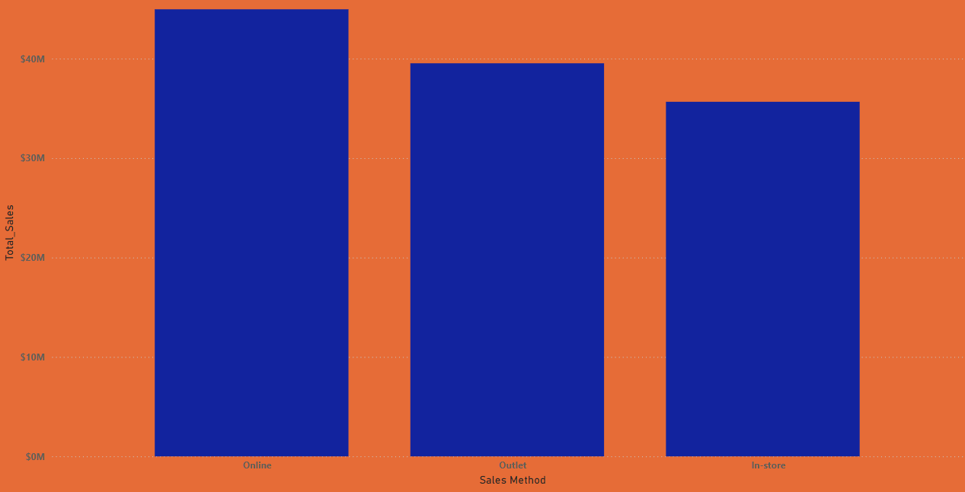
Stacked column chart
• Insight: Distribution of Total Sales and Sales Method
• Visual: Stacked column chart showing the size range and distribution of datasets

Slide 10
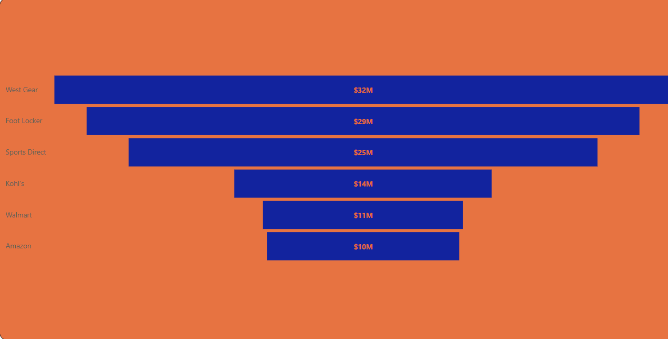
Funnel
• Insight: Distribution of Total Sales and Retailer
• Visual: Funnel chart showing the size range and distribution of datasets

Slide 11
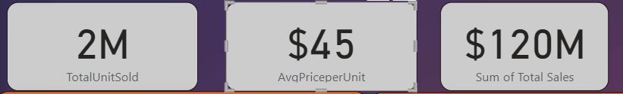
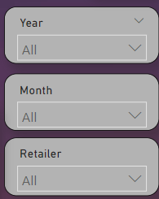
Card
• Insight: Fixed Representation of Data
• Visual: Total Unit Sold,Avg Price per unit,Sum of Total Sales
Slicers
•Insight: Filtration of the Dataset.
• Visual: Slicers visual is used to filter/find the dataset based on some condition

Slide 12
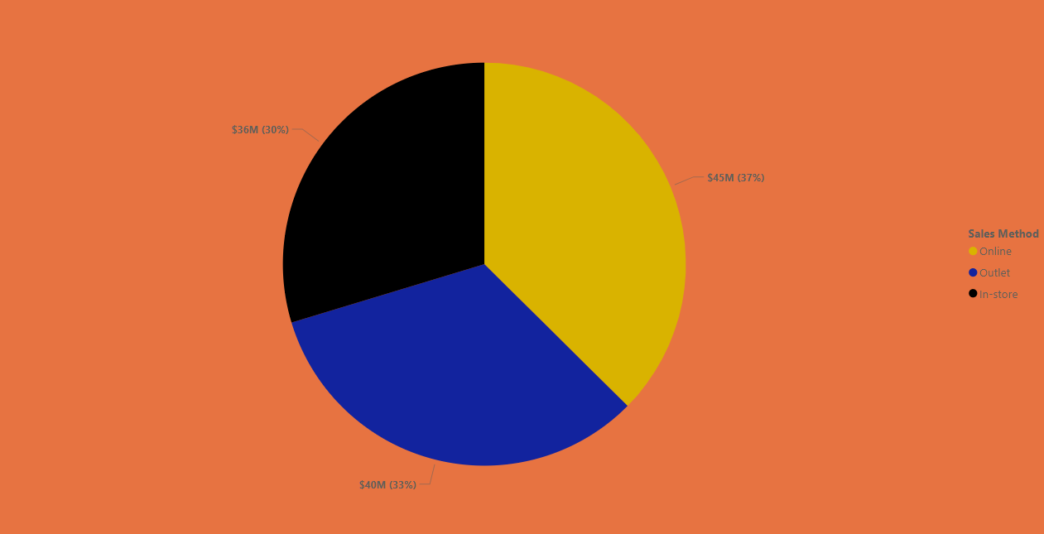
Pie Chart
• Insight: Distribution of Total Sales and Sales Method
• Visual: Pie Chart showing the size range and distribution of datasets

Slide 13
Q/A
Which retailer had the highest total sales?
Answer:- Wear Gear
Which product category generated the most revenue?
Answer:- Men’s Street Footwear i.e ($2,76,80,769)
3. How many units of Men's Street Footwear were sold in total?
Answer:- 593K Units
Which city had the highest number of units sold?
Answer:- New York (1,11,954 Units)
5. What is the total operating profit for sales made in the Northeast region?
Answer:- $10 Million
What is the average price per unit across all products?
Answer:- $45 per unit for all products
Which sales method generated the highest total sales?
Answer:- Online Method ($4,49,65,657 ) or 37.42% of Total sales Method
What is the total number of units sold in New York City?
Answer:- 1,11,954 Units
9. What is the total sales amount for Women's Athletic Footwear?
Answer:- $14 Million

Slide 14
Final Dashboard

Slide 15
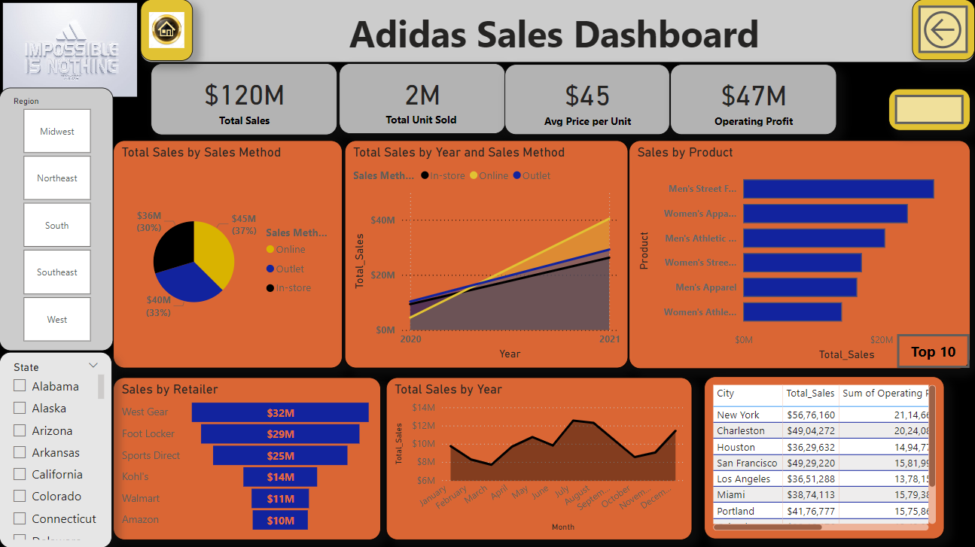

Slide 16
Conclusion
The analysis of the Adidas sales dataset reveals several key insights. A particular retailer significantly outperformed others in total sales, suggesting best practices that could be replicated elsewhere. The average operating margin indicates overall profitability and effective cost management. Certain product categories, like Women's Athletic Footwear, have generated substantial revenue, highlighting their popularity. Geographic analysis shows that cities like New York are strong markets, and the Northeast region, in particular, has notable operating profits. Different sales methods contribute variably to total sales, emphasizing the importance of optimizing sales strategies. Additionally, the average price per unit offers a benchmark for pricing across products. These insights collectively provide valuable guidance for strategic decision-making to enhance Adidas's sales performance and market presence.

Slide 17

Thank you
Mr. Kuber Dutta Sir (Trainer)
Presented By :- Mayank Kandpal (PGA-06)

